Slide 1
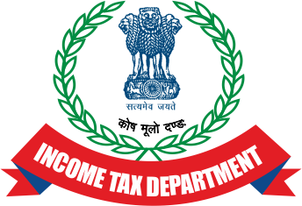
SEMINAR ON TDS/TCS ISSUES FOR AIN HOLDERS
BY
Commissioner of Income Tax(TDS)
Hyderabad
Thursday, 20th July ,2023 AMARAVATHI Auditorium, Mehdi Manzil Road No 12,Banajara Hills,Hyderabad.500034

Slide 2
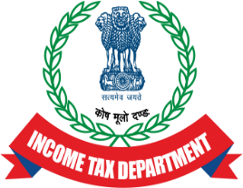
AIN
AIN denotes Accounts Officer Identification Number.
AIN is a special 7 digit identification number provided to each accounts office by the Directorate of Income Tax (Systems), New Delhi.
AIN application form is available on TIN website www.tin-nsdl.com .
AIN Form is to be submitted in physical form to the jurisdictional CIT.
The Accounts Office can register the AIN online and after registration, the AO can login with user ID and Password.
Upon login, the AO can view/download Book Identification Number (BIN) details and update demographic details etc.

Slide 3
AIN – 24G
Where tax is deducted/collected by government office, it can remit tax to the Central Government without production of income-tax challan except in few specific cases. The PAO/CDDO/DTO or Equivalent Office , who is responsible for crediting such sum to the credit of the Central Government, shall submit a statement in Form No. 24G to NSDL within the prescribed time-limit as per Income Tax Department Notification No.41/2010 dt.31.05.2010
Upon filing of Form 24G, a unique Book Identification Number (BIN) will be stated on the Tax Information Network (NSDL) after the respective Principal Accounts Officer files monthly statements with Form 24G. This BIN needs to be quoted in the quarterly returns.
It is mandatory for every Accounts Office to have an Account Identification Number while submitting Form 24G.

Slide 4
AIN Holder (Account Officer Identification Number)
24G ( Monthly Statement) for BIN Generation.
Details of TAN and the Total TDS Amount
Some correct TANs and Some False TANs inserted by Third Party Manipulator
TDS Quarterly Statements to be filed by respective TAN Holders/Deductors in Form 24Q/26Q
While Filing 24Q/26Q wrong PANs are inserted claiming the amount.
Wrong PAN holder claims the TDS credit by filing the Return of Income .

Slide 5
ATTEMPTS TO MISUSE AINs Manipulation of AINS (Accounts Officer Identification Number) of certain STOs and creating fraudulent TANS (Tax Deduction and Collection Account Number) for claiming bogus refunds
It was observed that certain persons were misusing the AINs in the name of State Government Departments and incorporating wrong entries while filling Form 24G returns:
Further, the bogus PAN holders, who were linked to the above bogus TANs would be filing returns and receiving refunds.
Often Form 24G is revised by filing the correction statements without the knowledge of the AIN Holder, as the login Id and Password credentials are handed over to the third party.
If Form 24G is filed with wrong entries, the TDS claimed by the bogus TAN holders will match at the time of processing Form 24Q and Form 26Q.
For Example, it was observed that there was sudden increase in TDS deducted from one STO in FY 2020-21. During the FY 2020-21, that STO submitted a data of Rs.2,10,25,949/- to the auditor. But the auditor had filed TDS return for Rs.25,83,98,009/-.

Slide 6
ATTEMPTS TO MISUSE AINs
In another instance, CIT (TDS) office received four (4) new applications for the allotment of AINs from 4 different STOs:
The TANs mentioned in these new AIN applications were also recently obtained in the name of the respective STOs.
The respective STOs mentioned that these were bogus TANs and not obtained by their respective offices, sought their deactivation/deletion.
On verification by AO with the respective STOs, it was found that no such application for a new AIN was filed by them.

Slide 7
AIN
In the recent times, the inactive/dormant AINs allotted to the District Treasury Officer / Cheque Drawing & Disbursing Officer / Pay & Accounts Officer [DTOs/CDDOs/PAOs] are being used as tools for fraud and manipulation by the fraudsters for making claims of bogus TDS credits/bogus refunds.
Inquires made revealed that the Drawing & Disbursing Officers in the Treasury Offices are availing the services of the Tax Practitioners/Tax Consultants for filing their periodical TDS statements 24G, etc. Thus the AINs and TANs of these authorities are being misused by the fraudsters in connivance with some of the officials in Treasury Offices. Instances have also come to notice that the unique User Ids. and Passwords for logging into the portals are also maintained by the Tax Practitioners / Tax Consultants and the DDOs are ignorant/unaware of even the credentials.

Slide 8
AIN
Complaints have been lodged with the police against the fraudsters and the Treasury officials and the Government of Andhra Pradesh has suspended some of the Treasury officials involved in the refund scam. The Tax Practitioner/Tax Consultant involved in the wrongdoing are being prosecuted and necessary criminal investigation against them is in progress.
In the context of large scale frauds being reported by misuse of Inactive and Dormant AINs and in some cases active AINs,It is to be ensured that the AIN application should be accompanied by a due diligence report of STO/DDO concerned and their supervisory authorities.

Slide 9
BIN
BIN Stands for Book Indentification Number and it consits of Seven Digit Unique Receipt Number generated for each Form 24G.
DDO Serial Number – Five Digit.
The last date of the month and year for which TDS/TCS is reported in Form 24G.
AO has to communicate the BIN details to the respective DDO.
BIN is to be quoted by the DDO in transfer voucher details in their quarterly TDS/TCS statements.

Slide 10
CASE STUDIES-1 Misuse of AINs and TANs of State Government Deductors for Claiming Refunds.
The Investigation Wing of the Income Tax Department have conducted Survey operations on certain Tax Practitioners/Consultants on 28.06.2023.
It has been found that the AINs(Account Officer Identification Number) and TANs of the state government deductors/ have been misused for claiming refunds. When the state government offices entrust the work of filing TDS returns to the third party(Tax Practitioners /Consultants), the Tax Practitioners /Consultants while filing details in Form 24Q, the 3rd party who is already in possession of information provided by the state government agencies/offices regarding the BIN amount, fraudulently enters some PANs on which it wishes to falsely claim refund in place of the original deductee PANs or non-PAN deductees and filed the return with NSDL-TIN facilitation centre by paying necessary uploading charges.
In one such instance, One Tax Practioner, who has been covered in the Survey had indulged in such practice and claimed refunds on account of fraudulent TDS credits against his own and his family members PANs as under:

Slide 11
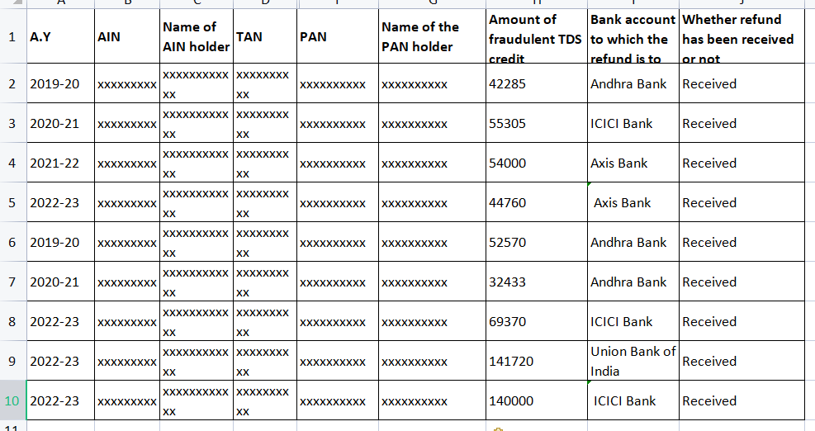

Slide 12
CASE STUDIES-2 Misuse of AINs and TANs of State Government Deductors for Claiming Refunds.
The 3rdparty (Fraudulent ITP/Tax Practitioner) obtains the TAN of the requisite state government office from internet through the link http://treasury.telangana.gov.in/ddolist.
Each AIN holder will have number of TANs that are specific to offices within the sub-treasury office. Each AIN holder will file Form 24G statements monthly and generate BIN (Book Identification Number) after making necessary book entries in central government account for the tax deducted by the different TANs under that AIN. The BIN so generated is auto populated in BIN view details once the AIN and TAN of deductor is entered. The above is the regular process followed by all the STOs/DDOs/PAOs.

Slide 13
CASE STUDIES-2 Misuse of AINs and TANs of State Government Deductors for Claiming Refunds.
The 3rd party (Fraudulent ITP/Tax Practitioner) can use the BIN view details facility available online to reach the ‘Tax Information Network’ of IT Department window wherein the 3rd party enters the AIN and TAN details to view the BIN details. After the BIN details for the specific period appear, there are 3 channels/options to the 3rd party to claim bogus refunds which are as under.

Slide 14
OPTION-1
While filing details in Form 24Q/26Q, the 3rd party who is already in possession of information provided by the state government agencies/offices regarding the BIN amount, fraudulently enters some PANs on which it wishes to falsely claim refund in place of the original deductee PANs or non-PAN deductees and file the return with NSDL-TIN facilitation centre by paying necessary uploading charges for claiming bogus refunds as detailed above.

Slide 15
OPTION 2:
The 3rd party will not have specific details of the BIN amount, but randomly enters a TDS amount which is to be claimed as refund and, if it matches with the BIN amount, the 3rd party will obtain the receipt number, DDO serial No, date of payment which are used to file the quarterly returns in Form 24Q. Since the BIN amount is matched with the amount entered, the deductees mentioned by the 3rd party in the return will get TDS credit in their Form 26AS. Once the TDS is reflected in the Form 26AS, the 3rd party will file the ROI of these deductees and after the return is processed, the deductee receives refund on account of the fraudulently claimed TDS credit.

Slide 16
OPTION 3:
The 3rd party will not have specific details of the BIN amount, but randomly enters a TDS amount which is to be claimed as refund and, if it is not matching with the BIN amount, the 3rd party can still take the details of receipt number, DDO serial No, date of payment etc from BIN View facility of Google etc to file quarterly statement in the Form 24Q by overbooking the TDS amount to claim bogus refund. However, since the BIN amount is not matched, the Form 26AS will reflect “Over Booked” status. Despite the overbooked status, the 3rd party will file the TDS quarterly statements to claim the bogus refunds. During the survey, it was found that the third Party has been following this method since the 3rd quarter of FY 2022-23 and so far he has not received any refunds against those overbooked PANs as returns are yet to be filed/processed. He has filed 20 such fraudulent TDS claim statements to claim the bogus refunds.

Slide 18
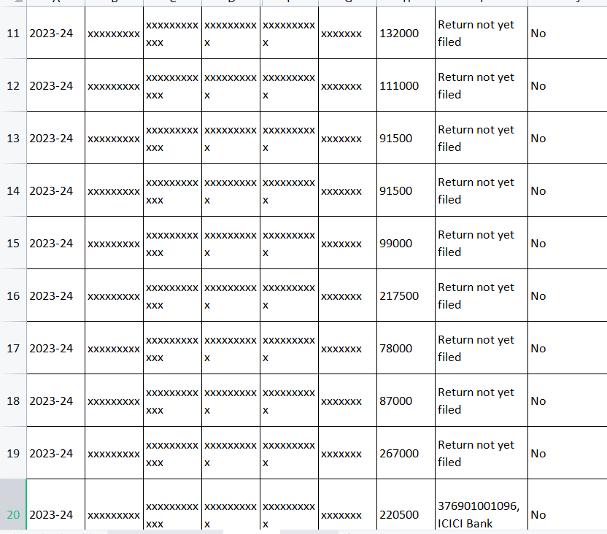

Slide 19
CASE STUDY -3
Misuse of AIN, TAN and PAN numbers and diversion of certain Government funds to individuals in the Financial Years 2015-16, 2016-17, 2017-18, 2018-19, 2019-20, 2020-21 and 2021-22 by TDS auditor with the support of officers and staff of Divisional/Sub Treasury of Chittoor District, Andhra Pradesh.
On comparing the TDS details reported in Form No. 24G by four AINs with the actual TDS details obtained from the respective AIN-holders for the period from FY 2015-16 to FY 2021-22, it is found that the four AINs have been misused to claim excess TDS amounts in Form No. 24G (in the form of fraudulent G-Oltas transfer vouchers), which were subsequently consumed by the TANs in their quarterly TDS statements in Form No. 24Q & Form No. 26Q and the excess bogus TDS was ultimately passed on to the PANs, who have fraudulently en cashed the refunds issued by CPC on processing of their Returns of Income.
FIRs were filed by Income tax department against four AIN holders as main accused and Tax Auditors as co accused.

Slide 20
THE MODUS OF FRAUD
During the course of investigation, fraudulent G-Oltas transfer vouchers have been analysed and the following points are observed:
Some TANs used are genuine TANs pertaining to STOs and DDOs.Some TANs are bogus TANs. Even one non-government TAN was used to allot bogus TDS amounts.
Wrong DDO names were mentioned against the TANs in Form-24G statements.
Apart from actual TDS data, some bogus entries were made in the Form-24G statements filed, allotting TDS to various TANs. In many cases, the bogus entry value is even more than the aggregate of the actual TDS amounts of all the DDOs under the AIN for the month.
The TANs not belonging to the jurisdiction of the AIN holder were also used in Form-24 statements.
Some of the fraudulent G-Oltas transfer vouchers are fully consumed. Some are partially consumed. Some are not yet consumed.

Slide 21
Lapses of AIN/TAN/PAN Holders
As per the investigation conducted at field level, the following lapses are observed on part of the Treasury Personnel, which led to bogus refunds fraud:
The TDS data filed in Form-24G was not cross checked and verified with the actual TDS data of Sub Treasury Offices in their books of account/ CFMS portal/ Impact portal.
It seems that the AG audit and the internal auditors of Sub Treasury Office have not verified the correctness of the data filed in the Form-24G.
This kind of refund fraud has become possible since all the stake-holders i.e., AIN- holders, TAN-holders and PAN-holders have taken the assistance/help of the same Auditor/Tax-Practitioner for filing their Income Tax Returns and that Auditor/Tax-Practitioner has entered matching amounts in the Income Tax Returns at AIN-level, TAN-level and PAN-level for claiming excess TDS and obtaining fraudulent refunds.

Slide 22
CHECK-LIST to prevent misuse of AIN/ TAN credentials provided to the Accounts Officers/DDOs for the purpose of filing 24G Statements/ quarterly TDS returns/ statements
All AIN/ TAN holders may check the contact details (Mobile number and e-mail ID) furnished at the time of registration of their respective AIN/TAN and also as per the latest statement filed. In case, the contact details are not that of the existing AIN/ TAN holder, the same may be updated immediately with that of the existing AIN/ TAN holder.
All AIN/ TAN holders may update their respective log-in ID and password credentials from time to time.
The DDOS may reconcile 26Q statement with the actual contract payments and percentage of non-salary TDS mentioned thereof from time to time. In case of 194C, the applicable rate of TDS is either 1% for Individuals and HUF or 2% for others. In case of incorrect PAN/ non furnishing of PAN, the applicable rate is 20%.

Slide 23
CHECK-LIST to prevent misuse of AIN/ TAN credentials provided to the Accounts Officers/DDOs for the purpose of filing 24G Statements/ quarterly TDS returns/ statements
In case of any third party assistance is taken for filing of Returns/ Statements, etc., the Statement filed may be reconciled by the AIN/ TAN holders with the data furnished to the third party. The reconciliation sheet may be maintained for the statements filed. In case of AIN holder, the number of TANS and BIN values may be matched with the Statement filed. In case of TAN holder, the number of PANs and credit given for each PAN may be reconciled with the BIN amounts and also actual TDS deducted for those PANS. In the case of any private TANS/ private PANs noticed in any of the Statements filed, it may be reconciled with the bills/ pay bills raised to verify the genuineness of the TDS credit given.
It has been informed that the AIN/TAN holders are apparently engaging the same third party for filing 24G statements as well as quarterly TDS Returns while sharing their login ID and password credentials for both AIN/ TAN with the same third party, which is not advisable. In such a scenario, it may be advisable for the AIN TAN holders to reconcile statements (Original/ Correction statements) being filed by using their login ID and password from time to time. The issues that need reconciliation are given as examples below.

Slide 24
EXAMPLES
Example-1: In case of a DDO who has deducted salary TDS he/she has to file 24Q statement only. But on reconciliation and verification, if he/she finds 26Q statement is also filed (for non-salary TDS) for the same quarter, he/she may immediately reconcile the BIN details along with the bills raised under salary and non-salary TDS for the respective months and bring it to the notice of his/her higher authorities as well as Income Tax Department in case of any discrepancy found.
Example-2: In case of a DDO who has deducted both salary and non-salary TDS for the same quarter and filed 24Q & 26Q statements, and there are no further correction statements filed for the same quarter. But on reconciliation and verification, if he/she finds any discrepancy in 26Q statements being revised repeatedly after sometime, without his/her knowledge and authorization by any third party by using his/her credentials, he/she may bring it to the notice of his/her higher authorities as well as Income Tax Department immediately.

Slide 25
CHECK-LIST to prevent misuse of AIN/ TAN credentials provided to the Accounts Officers/DDOs for the purpose of filing 24G Statements/ quarterly TDS returns/ statements
It may be advisable for all AIN/ TAN holders to have in-house capacity to file 24G statements and quarterly TDS Returns. Otherwise, in case of any reliance on third party, the login ID and password credentials of AIN/ TAN holder shall be in their custody and passwords may be updated from time to time to prevent any frauds.
The above check-list advisories may be brought to the attention of the Officers and Officials including DTAOs/ STOs/ ATOs/ DDOS working in all the Departments of Government of Telangana including the Directorate of Treasuries and Accounts, and the Directorate of Works Accounts for the needful.

Slide 26
LEARNING OUTCOMES
Login credentials for TIN-Protean and TRACES portal need to be diligently used by the Accounts Officer concerned.
Need to identify inactive AINs/TANs and initiate the process of deactivation/deletion as per the mandate of Central Action.
To verify the contents of the Form 24G filed by each Accounts Office for the past 5 to 10 months and check whether any wrong TDS credits were given to any TANs.

Slide 27
LEARNING OUTCOMES FOR PAOs/ APAOs/DTOs/STOs
In your in-house monthly report filed by you to your Higher Authorities, a mention should be made regarding the timely filing of Form 24G and reconciliation.
Develop in-house skills relating to filing of Form 24G to prevent any fraudulent practises by unscrupulous persons in future
Be in touch with the TDS Officers in your jurisdiction on their official email-id, so as to enable knowledge sharing and queries resolution relating to TDS provisions, filing of Form 24G and other related matters

Slide 28
QUERIES ??
Email-id 1
Hyderabad.dcit.tds1.1@incometax.gov.in
Email-id 2
Hyderabad.ito.tds1.1@incometax.gov.in

